Slide 1
BAPIC 2024 Conference – Reaching for Excellence
February 9, 2024

Slide 2
Florida Department of Health
Prioritizing Educational Needs in
Long-term Care (LTC) Settings
Notes:
Not an approved slide

Slide 3
Presenter
Jacqueline Whitaker, RN, MS, CPHQ, CPHRM, CIC, FAPIC
Educator Team Lead
Florida Department of Health
Health Care-Associated
Infection Prevention Program
Notes:
Not an approved slide
Registered nurse for 42 years. 34 years in infection control leadership positions in multi-entity health care organizations and most recently with HAI Prevention Program since October 2020.

Slide 4
Relevant Financial Disclosures
There are no financial relationships to disclose.

Slide 5
Learning objectives
Understand how the infection prevention and control educator program was created.
Explain how the Florida Department of Health (FDOH) improved the knowledge of frontline health care workers to prevent transmission of disease.
Describe how FDOH designed and implemented a train-the-trainer program as part of Occupational Safety and Health Administration (OSHA) Standard 1910.134.
Notes:
Pre-approved slide
Audience: Professional organization members, FHA, FHCA, APIC, etc.
FDOH HAI Prevention Program is one of PFL's 75 healthcare, academic, and public health partners

Slide 6
HAI Prevention Program
Mission | To promote the prevention and control of health care-associated infections and antimicrobial-resistant organism infections using surveillance methods, evidence-based prevention and control strategies through the collaboration of private and public health agencies.
Vision | To reduce HAIs within the Florida health care system.
Notes:
Pre-approved slide
Audience: Professional organization members, FHA, FHCA, APIC, etc.
Ask Isabella to look at this slide ; coloration and image resolution

Slide 7
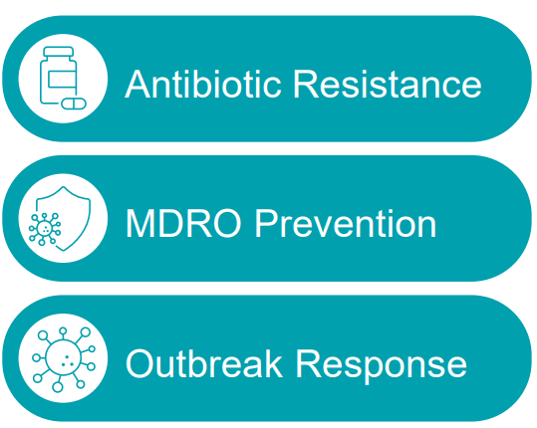
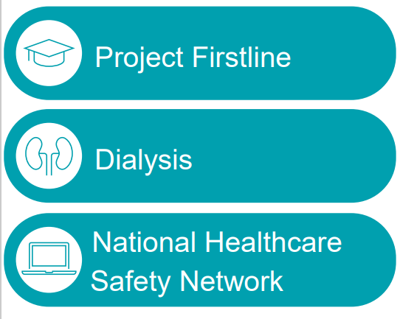
HAI Prevention Program, Continued.
Priority Focus Areas:
Notes:
Pre-approved slide
Audience: Professional organization members, FHA, FHCA, APIC, etc.
FDOH HAI Prevention Program is one of PFL's 75 healthcare, academic, and public health partners

Slide 8
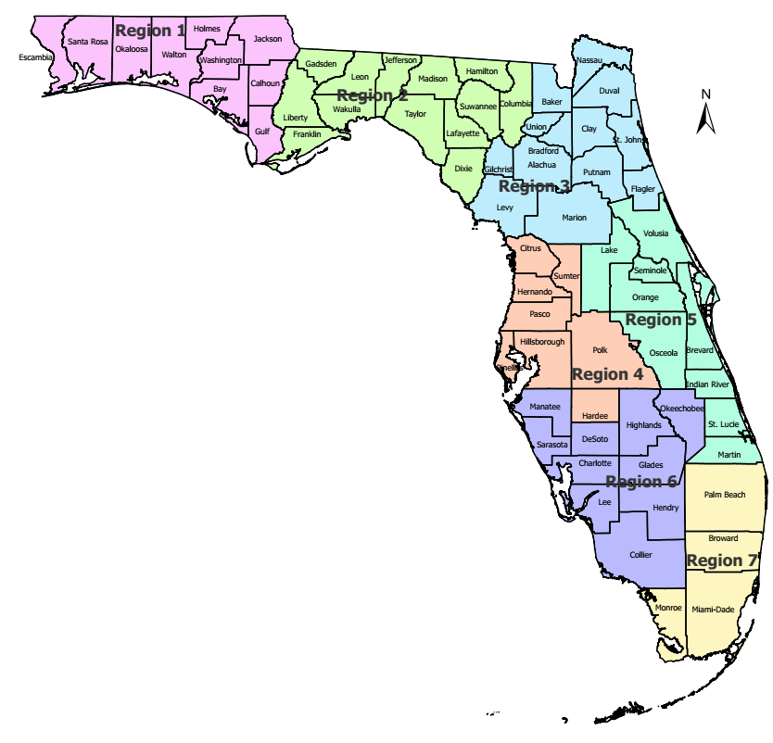
HAI Prevention Program, Continued.
67 counties, 7 regions
48 team members
6 Project Firstline educators
17 Regional infection preventionists
15 Regional and local epidemiologists
4 Data analysts
6 administrative support staff
20 certified in infection control (CIC)
Notes:
Not approved slide

Slide 9
Project Firstline (PFL)
PFL is a CDC collaborative that aims to provide engaging, innovative and effective infection control training for health care workers and members of the public health workforce.​
PFL reaches health care workers in a variety of health care settings, including:​
Hospitals​.
Outpatient clinics​.
Dialysis centers​.
Nursing homes​.
Notes:
Pre-approved slide
Audience: Professional organization members, FHA, FHCA, APIC, etc.
FDOH HAI Prevention Program is one of PFL's 75 healthcare, academic, and public health partners

Slide 10
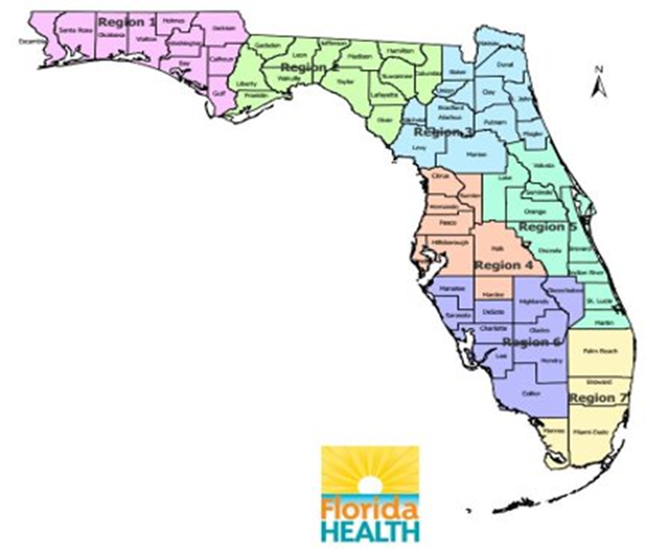
Project Firstline (PFL), Continued.
Regions 1 and 2: Melanie Manney
melanie.manney@flhealth.gov
Regions 3 and 5: Sasha Nelson
sasha.nelson@flhealth.gov
Region 4: Alexis Guttenberg
alexis.guttenberg@flhealth.gov
Region 6: Charlee Ford
charlee.ford@flhealth.gov
Region 7: Barbara Russell
barbara.russell@flhealth.gov
Notes:
Pre-approved slide
Audience: Professional organization members, FHA, FHCA, APIC, etc.

Slide 11
Project Firstline (PFL) cont.
PFL training materials and educational activities help empower health care workers in building their foundational knowledge of infection control principles and practices.​
Notes:
Pre-approved slide
Audience: Professional organization members, FHA, FHCA, APIC, etc.
FDOH HAI Prevention Program is one of PFL's 75 healthcare, academic, and public health partners

Slide 12
Project Firstline (PFL) cont.
Respiratory Protection Program (RPP), including train-the-trainer fit testing
Enhanced Barrier Precautions
MDRO prevention and outbreak management
EVS Step-by-Step
Notes:
Not an approved slide
Examples of education sessions offered to health are settings include the above.
Use of science based recommendations during education and ICAR site visits, CDC, OSHA, APIC, etc.
Respiratory Protection Program – OSHA standard
Enhanced Barrier Precautions – CDC guidelines
MDRO prevention and outbreak management – CDC guidelines
EVS Step-by-Step – CDC guidelines This presentation was created from identified knowledge gaps in EVS workers throughout the state.

Slide 13
CDC Learning Needs Assessment (LNA) Survey
Date parameters: June 2021—August 2021
121 question survey sent via email to LTC facility leaders in Florida.
English and Spanish versions.
Promoted during on-site ICAR assessment.
Purpose of survey:
knowledge of infection control and prevention practices
desired educational needs, and
preferred learning platform.

Slide 14
LNA Topic Overview
Demographics
Preferred learning platform
Likert scale survey evaluating
Personal protective equipment (PPE)
Hand hygiene
Environmental cleaning and disinfection
Triage and screening
COVID-19
Education topics of interest

Slide 15
Respondent Roles by Organization
2021 LNA

Slide 16
Most Requested Education Topics

Slide 17
Education Topics by Participant Role

Slide 18
Learning Platform

Slide 19
2021 LNA Results
Virtual learning platform
Top 3 education topic requests:
Source control
COVID-19
Environmental cleaning

Slide 20
One Day Training Seminar
June 2022
496 registrants
Offered continuing education credits
Creative Ways to Enhance Infection Prevention and Control Practices; Moving Your Team to a Higher Level of Confidence.
Introduction to the PFL Educator Role and Zoonotic Disease IPC Considerations.
Vaccine Preventable Diseases in Long-term Care.
Overview of OSHA Respiratory Protection Standard,
Auditing Program Best Practices in Long-term Care.

Slide 21
N95 Respirator Use in LTC Settings
OSHA enforcement of standard.
Evaluation of Research Electronic Data Capture (REDCap) data.
Respiratory protection program in LTC settings.
Lack of infection prevention education with respirator use.
Lack of resources
Supplies (e.g., fit test kits, PPE shortages).
Personnel (e.g., leadership turnover, licensed health care professional, medical evaluation).

Slide 22
Project Firstline Education
Respiratory Protection Program (RPP), including train-the-trainer fit testing
OSHA Standard 1910.134
Demonstration of qualitative fit test process
Return demonstration
Certificate of attendance
Notes:
Not an approved slide
Use of science based recommendations during education and ICAR site visits, CDC, OSHA, APIC, etc.
Examples of education sessions offered to health are settings include the above.

Slide 23
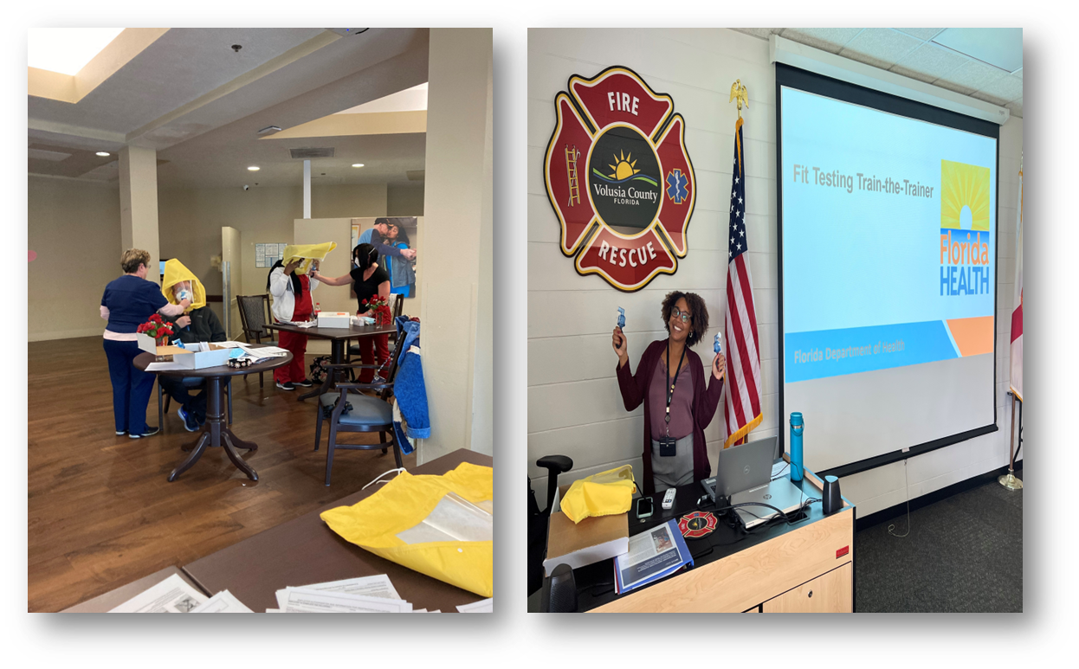
N95 Fit-Test Respirator Training
Train-the-Trainer Education Sessions
Notes:
Pre-approved slide
Audience: Professional organization members, FHA, FHCA, APIC, etc.

Slide 24
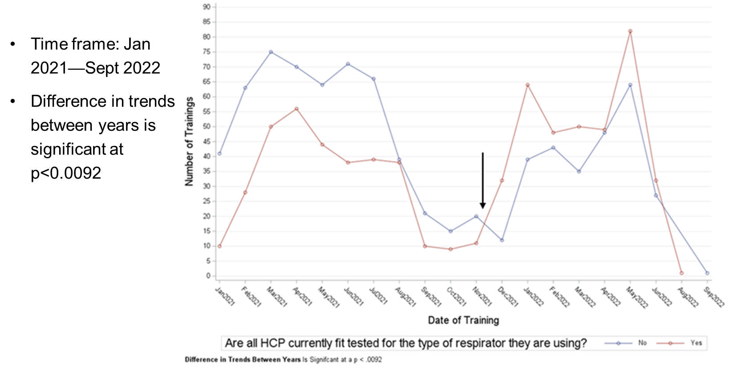
N95 Fit-Test Respirator Training
Notes:
Pre-approved slide
Audience: Professional organization members, FHA, FHCA, APIC, etc.

Slide 25
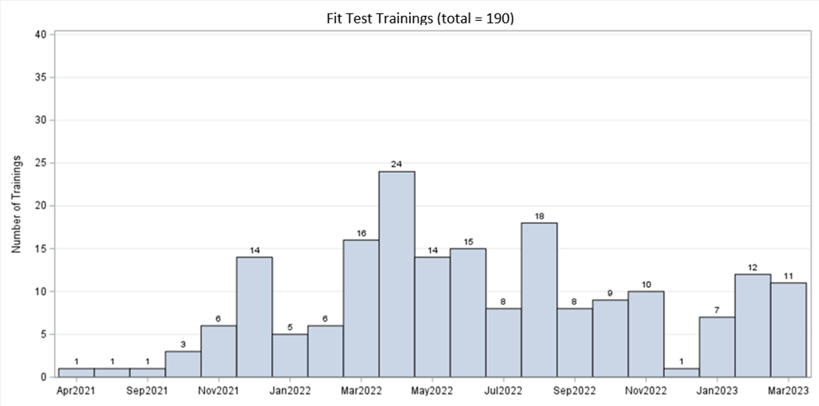
RPP Training April 2021 to March 2023
Notes:
Pre-approved slide
Audience: Professional organization members, FHA, FHCA, APIC, etc.

Slide 26
Follow-up Learning Needs Assessment Survey
Notes:
Pre-approved slide
Audience: Professional organization members, FHA, FHCA, APIC, etc.

Slide 27
Follow-up LNA
Date parameters: February 2022—April 2022
121 question survey sent via email to long-term care facility leaders in Florida.
English and Spanish version.
Promoted during on-site ICAR assessment.
Purpose of survey:
knowledge of infection control and prevention practices.
desired educational needs.
referred learning platform.
Notes:
Pre-approved slide
Audience: Professional organization members, FHA, FHCA, APIC, etc.

Slide 28
Respondent Roles by Organization
2022 LNA

Slide 29
Most Requested Education Topics
2022 LNA

Slide 30
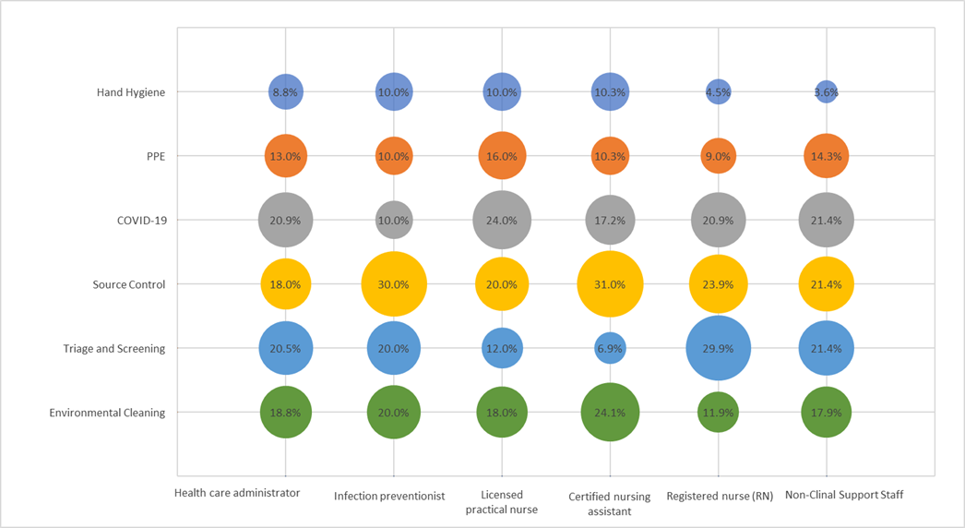
Education Topics by Participant Role
2022 LNA

Slide 31
Infection Control Assessment and Response (ICAR)

Slide 32
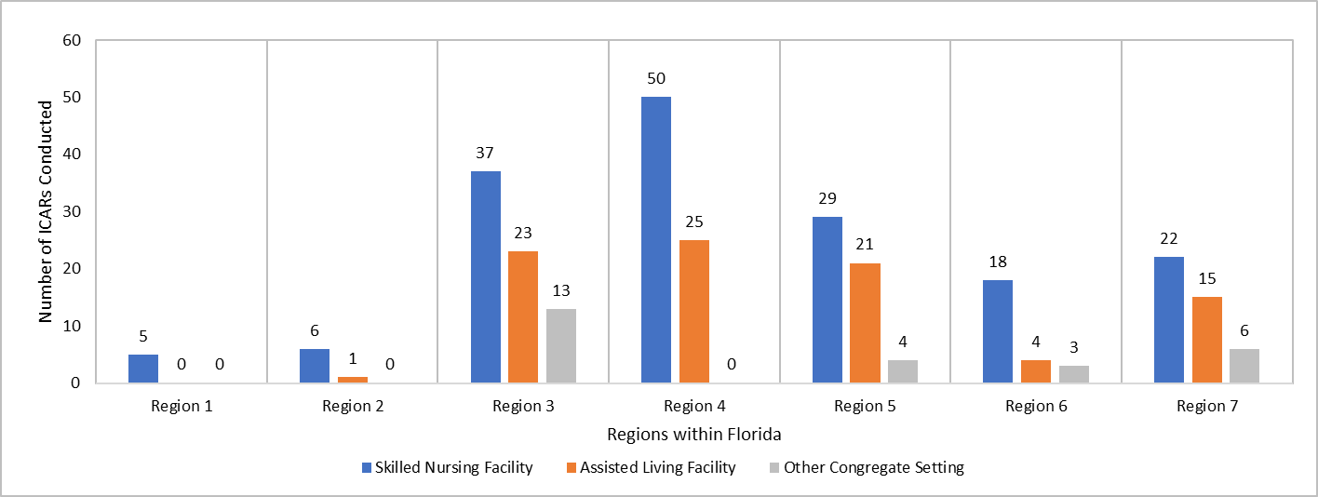
Infection Control Assessment and Responses (ICARs) Conducted by Region in Congregate Settings April 2020 - December 2020
Total completed: 282
Notes:
Pre-approved slide
Audience: Professional organization members, FHA, FHCA, APIC, etc.
Daily monitoring of statistics
Assignment of HAI Team member(s)
Outbreak response was initially under Emergency Management and then moved to HAI Prevention Program oversight.
Amy Wang is creating a graph with the same colors as slide 7 and 8.

Slide 33
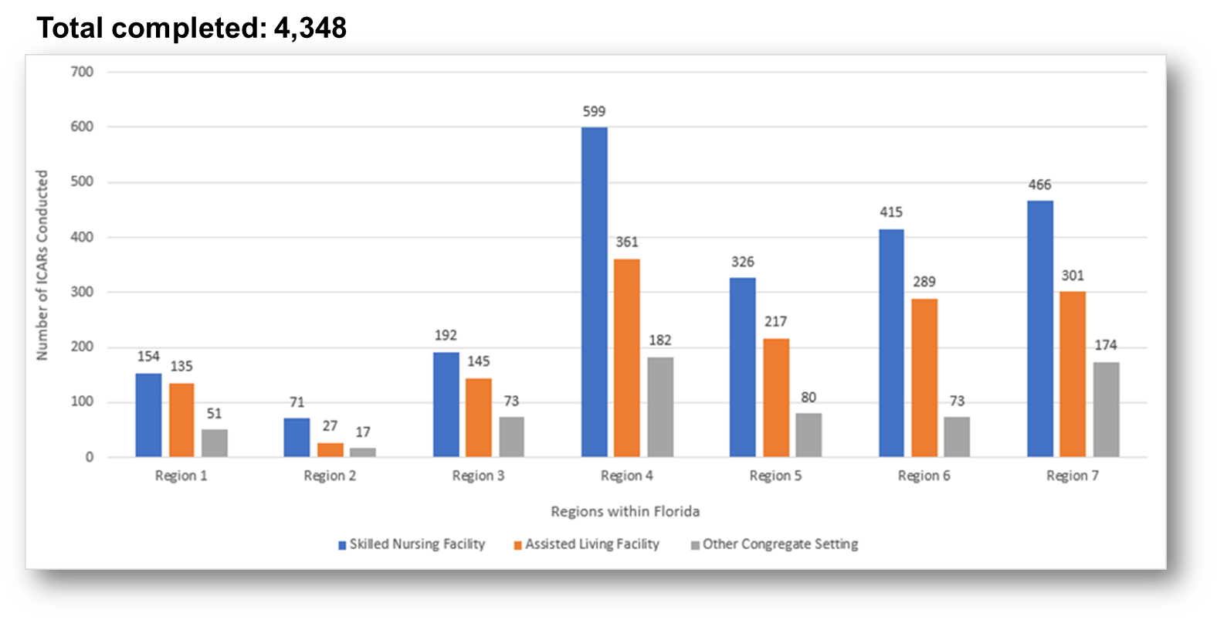
ICARs Conducted by Region in Congregate Settings January 2021 - December 2021
Notes:
Pre-approved slide
Audience: Professional organization members, FHA, FHCA, APIC, etc.

Slide 34
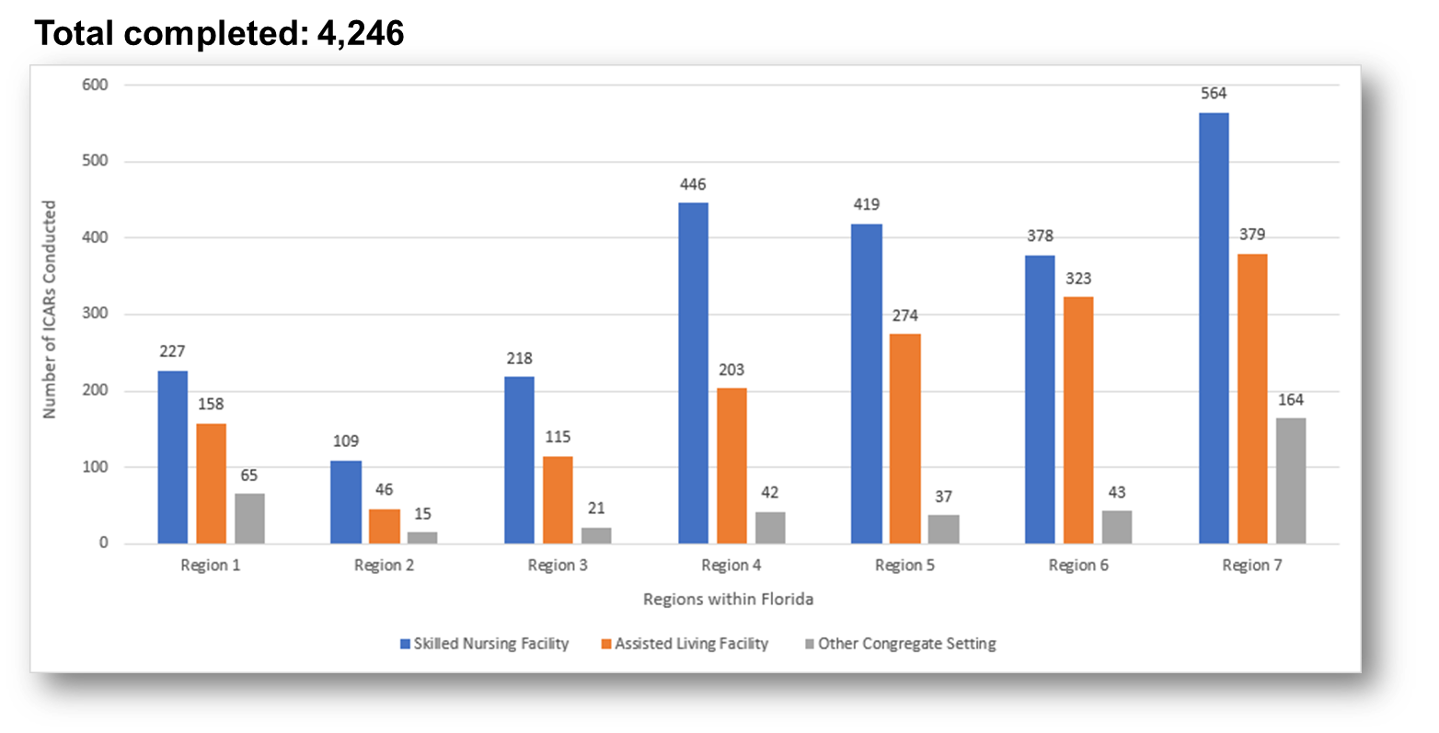
ICARs Conducted by Region in Congregate Settings January 2022 - December 2022
Notes:
Pre-approved slide
Audience: Professional organization members, FHA, FHCA, APIC, etc.

Slide 35
Outbreak Response ICAR Outcomes
Analysis conducted during the time of the Omicron surge.
April 4, 2021 - March 11, 2022.
Sample included over 2,700 ICARs.
Results showed:
Facilities who received ICARs had approximately 15% (RR 0.85, CI 0.79-0.9, p < 0.0001) lower resident case counts in subsequent outbreaks versus the control group.
Notes:
Not an approved slide
The HAI Prevention Program responds to ILI outbreaks at LTCFs to assist with prompt identification of IPC gaps in an effort to mitigate transmission and prevent further positive cases. This response differs from Preventative ICARs in the fact they are targeted to the pathogen of concern and reviews best practice guidance pertaining to the outbreak.
To assess the success of the HAI Prevention Program, an analysis was conducted during the time of the Omicron surge, from April 4, 2021, to March 11, 2022. The purpose was to explore the effect that ICARs had on facilities during COVID-19 outbreaks. The sample included over 2,700 reports to FDOH during ongoing COVID-19 surveillance.
A one-way between-groups analysis of variance was conducted to explore the association of days until subsequent Covid-19 outbreak (continuous range 0-300) and follow up ICAR (yes/no). To better control for confounding variables and to further elucidate the effect of ICARs on outbreaks performed, a regression analysis using infection counts on the facilities that indicated subsequent outbreaks as the outcome with the primary exposure of interest as ICARs was conducted. The other variable used in the equation were total number of ICARs performed. All analysis and data cleaning were performed using SAS 9.4 (Proc SQL, GenMod).
Regression analysis showed that facilities who received ICARs had approximately 15% (RR 0.85, CI 0.79-0.9, p < 0.0001) lower resident case counts in subsequent outbreaks versus the control group (facilities that did not receive an ICAR). These promising results show a true benefit in FDOH’s COVID-19 outbreak response at LTCFs.

Slide 36
Outbreak Response ICAR Outcomes, Continued.
In 2023, 162 ICARs were reviewed.
Most common recommendations per module.
Module 2 – Hand Hygiene.
Least common recommendations per module.
Module 1 – Training, Audits, and Feedback.
Notes:
Not an approved slide
A review of 162 ICAR Reports from 2023 showed the module which yielded the largest average number of recommendations compared to number of times used at ICARs was Module 2 – Hand Hygiene. Out of 90 times being utilized, there were 318 total recommendations made, which resulted in an average of 3.5 recommendations every time Module 2 was used. What this means is that every time Module 2 was selected to be utilized at a facility, there was an average of 3.5 instances where an IPC gap was identified. (This may be good to plug our new low HH initiative with PFL?)
The lowest amount of recommendations per module was Module 1 – Training, Audits, and Feedback. Out of a total of 57 times the module was utilized, only 10 recommendations came from it resulting in 0.17 recommendations per module usage. This module to does not include observations, but rather reviews facility policy. This is key to note as many facilities have sound IPC policy but observations of real-time IPC practices may show a different story.
Further analysis to come as more data is collected.

Slide 37
Prioritizing Future Education in LTC
Third LNA to be released March 2024.
Gaps in infection prevention practices to be re-evaluated utilizing data from ICAR assessment.
Frontline workers will be targeted with an emphasis on disciplines not captured in previous LNAs.
This includes rehabilitation staff, certified nursing assistants, dietary staff, and environmental service staff.

Slide 38
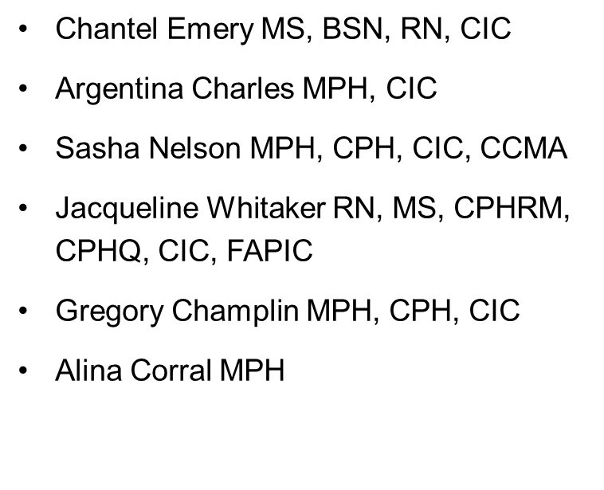
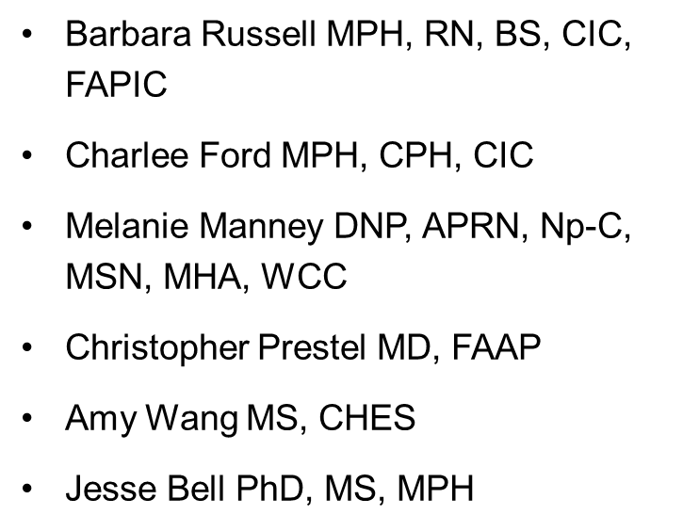
Acknowledgements
Notes:
Pre-approved slide
Audience: Professional organization members, FHA, FHCA, APIC, etc.
Daily monitoring of statistics
Assignment of HAI Team member(s)
Outbreak response was initially under Emergency Management and then moved to HAI Prevention Program oversight.
Amy Wang is creating a graph with the same colors as slide 7 and 8.

Slide 39
References
Notes:
Pre-approved slide
Audience: Professional organization members, FHA, FHCA, APIC, etc.
Daily monitoring of statistics
Assignment of HAI Team member(s)
Outbreak response was initially under Emergency Management and then moved to HAI Prevention Program oversight.
Amy Wang is creating a graph with the same colors as slide 7 and 8.

Slide 40
Summary
Connect with the Project Firstline Educator to determine how we can support your program.
Consider preventative ICAR to review IPC program elements.
Contact the designated HAI Team representative for support in our six priority focus areas.

Slide 41
Contact Information
State contact
HAI_Program@flhealth.gov
County health department contacts
FloridaHealth.gov/diseases-and-conditions/disease-reporting-and-management/chd-epi-contacts/
MDRO Prevention and Outbreak Response
jalysa.erskine@flhealth.gov
Project Firstline (PFL)
jacqueline.whitaker@flhealth.gov
Dialysis
chantel.emery@flhealth.gov
Antimicrobial stewardship
chava.chaitain@flhealth.gov
COVID-19 prevention and response
gregory.champlin@flhealth.gov
NHSN
amy.wang@flhealth.gov
Notes:
Not an approved slide

Slide 42
Thank you!

Slide 43
BAPIC 2024 Conference – Reaching for Excellence
February 9, 2024

